Slide 1
Rhythm and Meter
Kostka/Payne Chapter 2

Slide 2
Note Duration
The length of time a note is played is called its note duration which is determined by the type of note.

Slide 3
Note Duration
Two half notes occupy the same amount of time as one whole note.

Slide 4
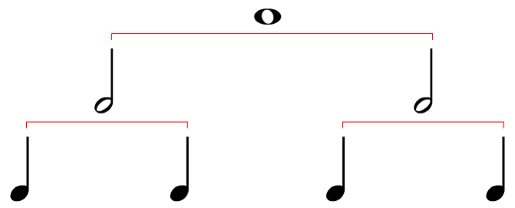
Note Duration
Four quarter notes occupy the same amount of time as one whole note.

Slide 5
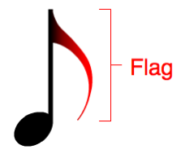
Note Duration
Notes smaller in duration than quarter notes have flags. Each flag halves the value of a note.

Slide 6
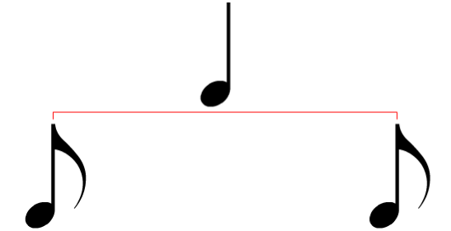
Note Duration
Two eighth notes occupy the same amount of time as one quarter note.

Slide 7
Note Duration
A sixteenth note has two flags and halves the value again.

Slide 8
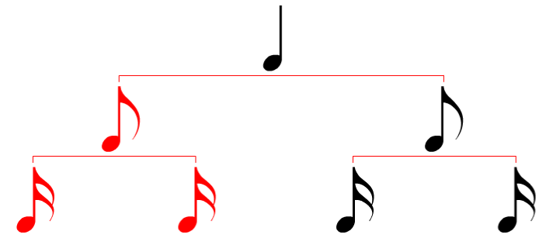
Note Duration
Two sixteenth notes equal the duration of an eighth note.

Slide 9
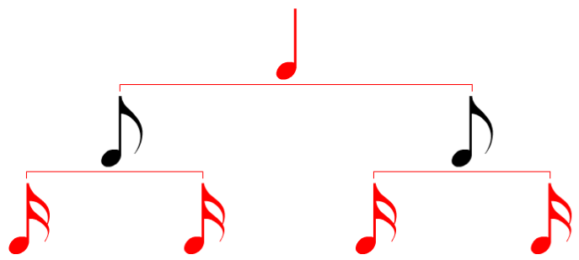
Note Duration
Four sixteenth notes equal the duration of one quarter note.

Slide 10
Note Duration
Notes with 3 or more flags are possible but infrequently used.

Slide 11
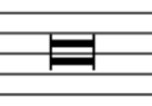
Note Duration
A Breve is equal to two whole notes.

Slide 12
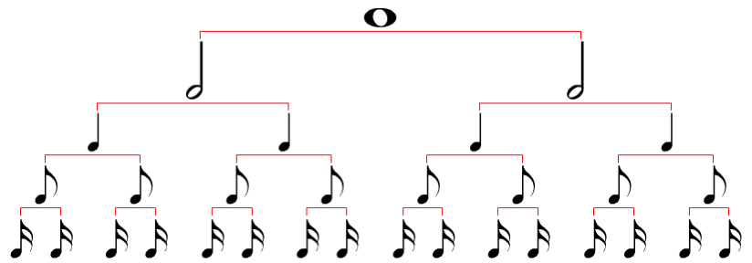
Note Duration

Slide 13
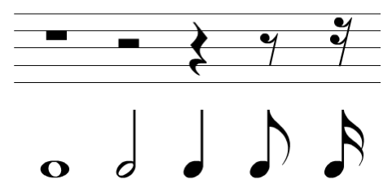
Rest Duration
Each rest shares an equivalent note in duration.

Slide 14
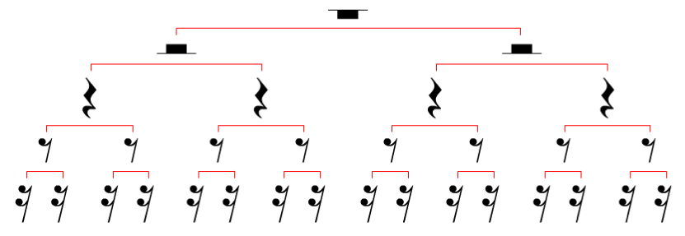
Rest Duration

Slide 15
Meter Types
Simple Meters
Top number is
2, 3 or 4
Beat divides into 2 parts
Beat note is NOT dotted

Slide 16
Meter Types
Compound Meters
Top number is
6, 9 or 12
Beat divides into 3 parts
Beat note is dotted

Slide 17
Meter Types
Duple
2 Simple
6 Compound
Triple
3 Simple
9 Compound
Quadruple
4 Simple
12 Compound

Slide 18
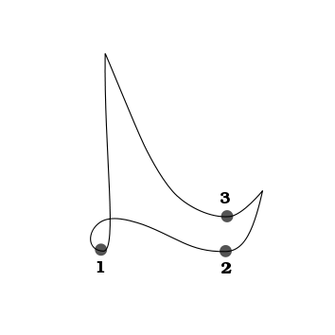
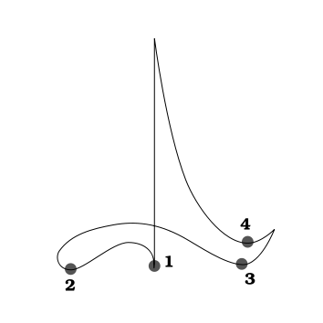
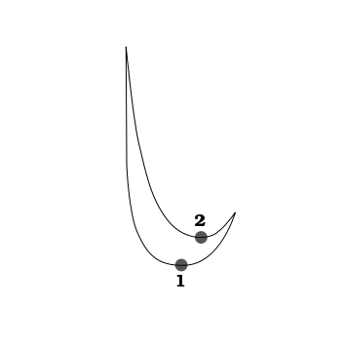
Conducting Patterns
Duple
Triple
Quadruple

Slide 19
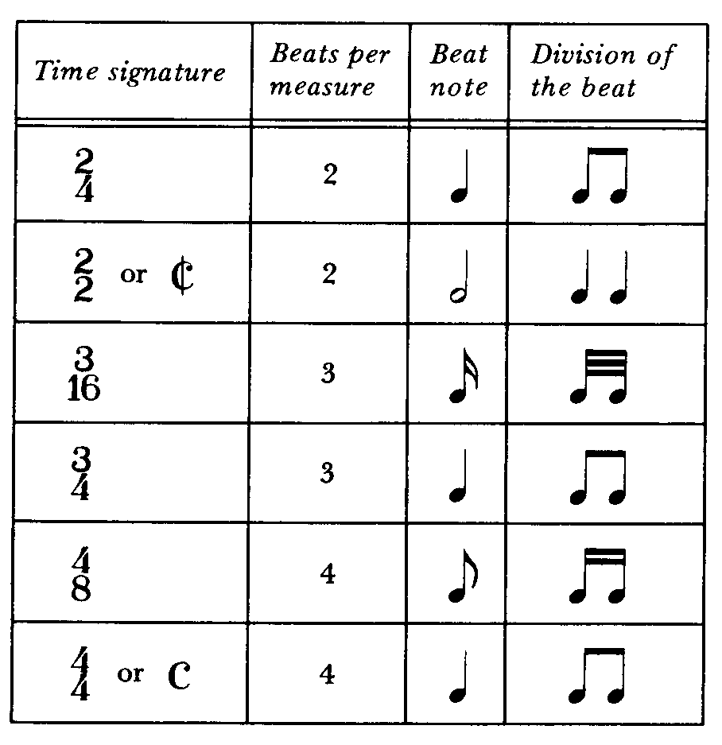
Simple Time Signatures

Slide 20
Simple Time Signatures
Ex 2-1

Slide 21
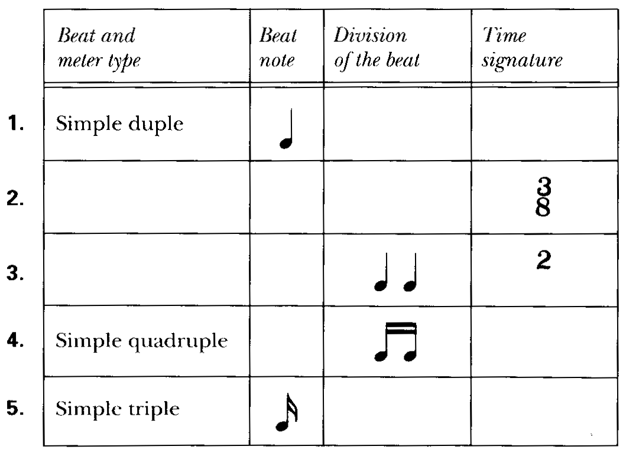
Simple Time Signatures

Slide 22
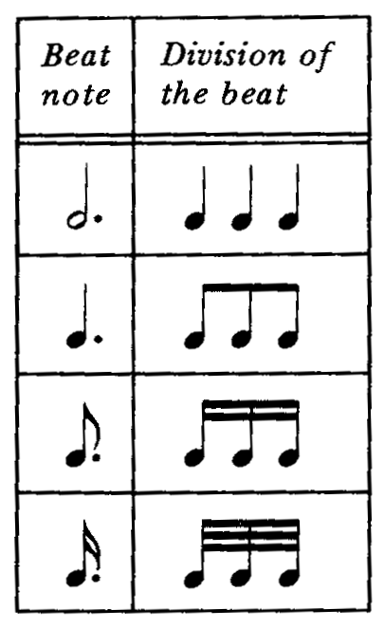
Compound Time Signatures
In compound time, the beat divides into three equal parts.
The beat note value will be dotted.

Slide 23
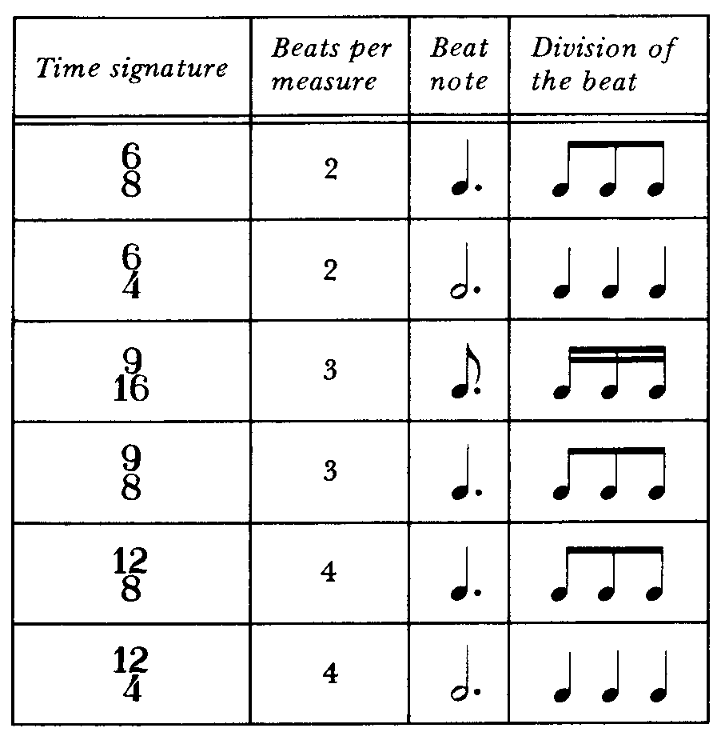
Compound Time Signatures

Slide 24
Simple Time Signatures
Ex 2-2

Slide 25
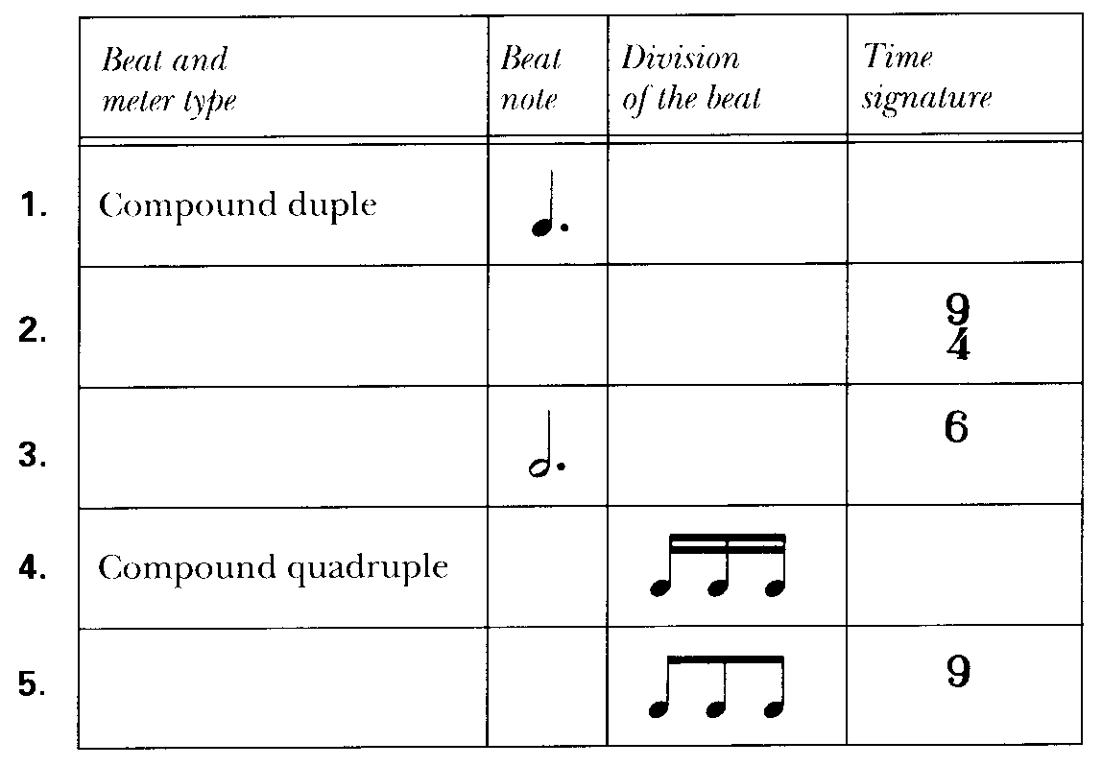
Compound Time Signatures

Slide 26
Meter Types
Meters that have top numbers of 5, 7, 8, 10, 11, etc. are considered ASYMETRICAL meters.
These meters have variable subdivisions.

