Slide 1
Elements of Pitch (Continued)
Kostka/Payne Chapter 1 – Part Two

Slide 2
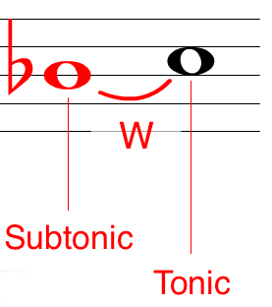
Scale Degree Names

Slide 3
Intervals
An interval is the measurement of the distance in pitch between two notes.
Harmonic/Melodic

Slide 4
Generic Intervals
Generic intervals, are measured on the staff or by letter name.
When two notes occupy the same line or space, they are a first (or a prime) apart.
UNISON
OCTAVE

Slide 5
Perfect Intervals
Learn modifiers for intervals by relating them to the intervals contained in the major scale.
Perfect (P) is a modifier used only in connection with Unisons, 4ths, 5ths, and 8ves.
To spell one of these intervals, you need only think of scale steps 1, 4, and 5 of that note’s key.
^
^
^

Slide 6
Major & Minor
_
Major (M) and Minor (m) are modifiers used only in connection with 2nds, 3rds, 6ths and 7ths.
If a major interval is made a half-step smaller without altering its numerical name, it becomes a minor interval.
You can make an interval smaller by lowering the top note or raising the bottom note.

Slide 7
Augmented and Diminished
If a perfect or a major interval is made a half step larger without changing the numerical name, the interval becomes augmented (+).
If a perfect or a minor interval is made a half step smaller without changing its numerical name, it becomes diminished ( ).
°

Slide 8
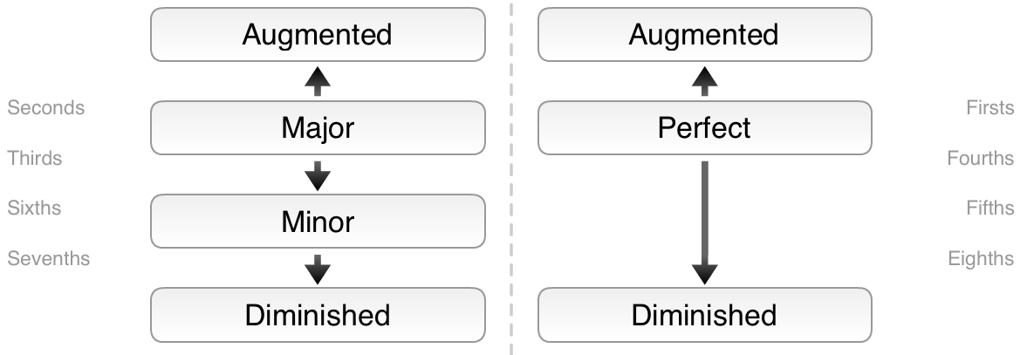

Slide 9
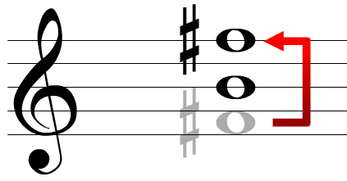
Interval Inversion
We invert an interval by putting the bottom pitch above the top one.
The new numerical name is always different from the old.

Slide 10
Interval Inversion
The new numerical name can be calculated by subtracting the old numerical name from 9.
9 9 9 9 9 9
-2 -3 -4 -5 -6 -7
7 6 5 4 3 2

Slide 11
Interval Inversion
The modifier also changes (with the exception of Perfect intervals).
_
°
m M P + °
_
°
M m P +

Slide 12
Interval Calculation
Another method for calculating intervals is to memorize the number of steps which comprise intervals up to a P4th, then apply inversions.
_
M2 1 step
M3 2 steps
P4 2½ steps
m2 ½ step
m3 1½ steps
_

