Slide 1
Elements of Pitch
Kostka/Payne Chapter 1 – Part One

Slide 2
Keyboard and Octave Register

Slide 3
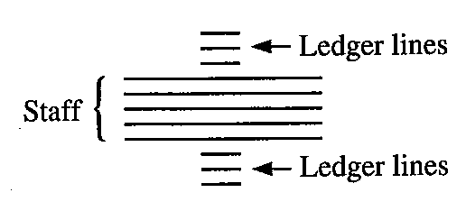
Ledger Lines
CLEFS

Slide 4
Movable Clefs

Slide 5
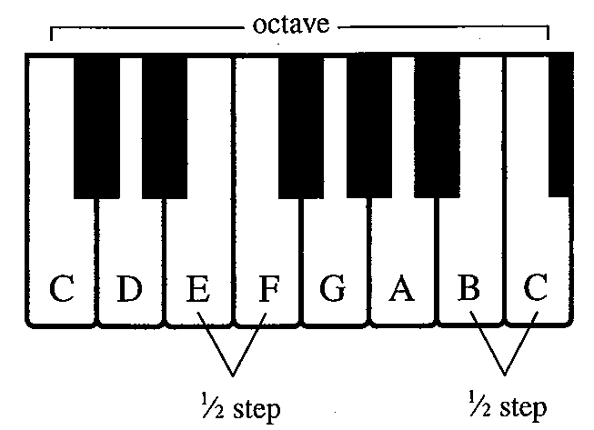
Half Steps
A half step is the distance from a key on the piano to the very next key (white or black.)
Using only white keys, there are two half steps in each octave.

Slide 6
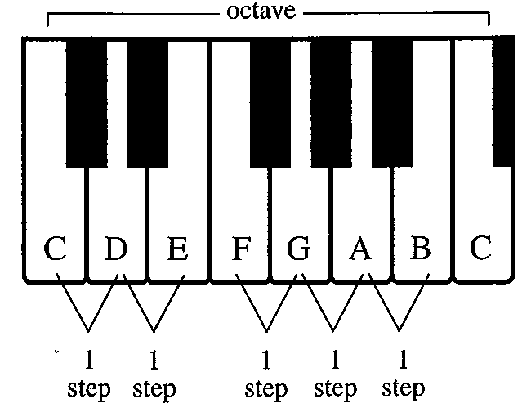
Whole Steps
A whole step skips the very next key and goes instead to the following one.
Using only white keys, there are five half steps in each octave.

Slide 7
The Major Scale
The major scale is a specific pattern of small steps (called half steps) and larger ones (called whole steps) encompassing an octave.

Slide 8
Major Scale -- E-flat
We can make the Eb scale conform to the major scale pattern by adding accidentals

Slide 9
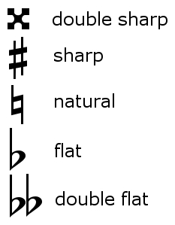
Symbols

Slide 10
The Major Key Signatures

Slide 11
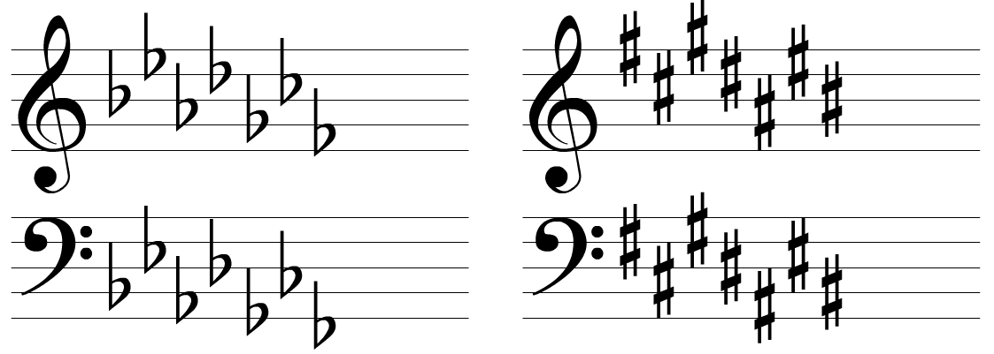
Order of Sharps and Flats

Slide 12
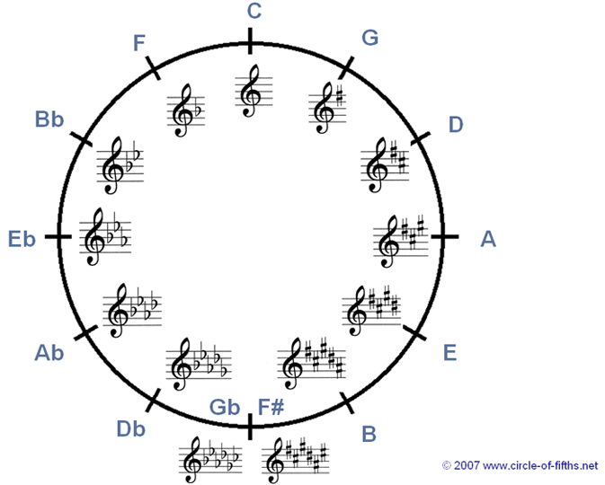
Circle of Fifths

Slide 13
Minor Scales
Always begin with the parallel major scale.
Lower the following scale degrees for each form of minor.
Natural
Harmonic
Melodic
The descending Melodic minor is the same as the natural minor scale

Slide 14
Minor Key Signatures
Minor key signatures conform to the natural minor scale, no matter which minor scale type is actually in use.
Relative Minor (shares the same key signature):
Determine the major key signature and then identify the minor 3rd (step and a half, or 3 half steps) below.
Parallel Minor (shares the same tonic note but has different key signatures.)

