Slide 1
Harmonic Progression
Kostka-Payne Chapter 7

Slide 2
Why is it that some chord successions seem to progress and others seem to wander and leave our expectations unfulfilled?

Slide 3
Ex 7-1
Progression A

Slide 4
Ex 7-1
Progression B

Slide 5
Terms:
Sequence – a repeated pattern of notes that begins on a different pitch class.
Tonal – keeps in the same key (diatonic) (intervals change.)
Real – transposes the pattern to a new key to keep the same intervals.

Slide 6
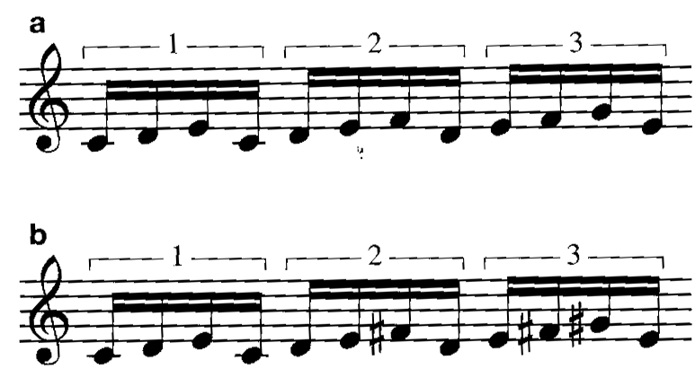

Slide 7
Terms:
Imitation– must occur in a different voice.
Sequences can be melodic or harmonic or both.

Slide 8
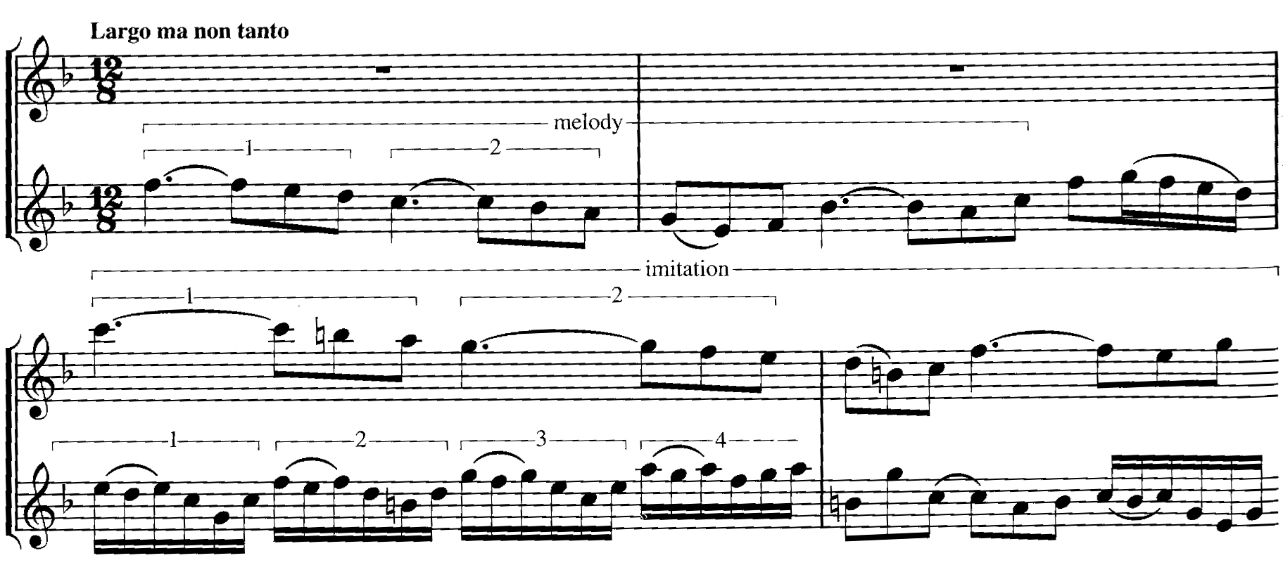
Terms:
Ex 7-3
Modified Sequence – neither tonal nor real.

Slide 9
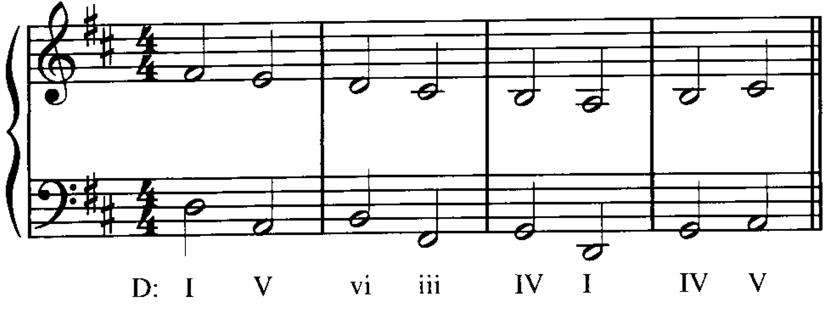
Circle of 5ths Progression
Descending 5th (or ascending 4th)

Slide 10
MusicTheory.net Common Chord Progressions

