Slide 1
Introduction to Triads and Seventh Chords
Kostka/Payne Chapter 3

Slide 2
Triads!
Tertian: Built of thirds.

Slide 3
Triads
There are four possible ways to combine major and minor 3rds to produce a tertian triad.

Slide 4
Triads
+ Major minor dim

Slide 5
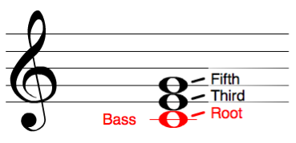
Triads: Members of the Chord
The notes (members) of the chords are given names.

Slide 6
Seventh Chords
If we extend a tertian triad by adding another 3rd on top of the 5th of the triad, the result is a four-note chord called a seventh chord.

Slide 7
Seventh Chords
Tonal harmony commonly makes use of only five seventh-chord types.

Slide 8
Seventh Chords
Major minor half dim. fully dim. Dom
°
°
Major/Minor 7th,
Mm7

Slide 9
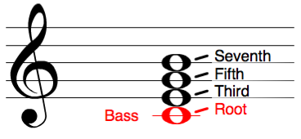
Sevenths: Members of the Chord
Just like Triads, the notes (members) of sevenths chords are given names.

Slide 10
Triad Inversions

Slide 11
Triads: Root Position
In Root Position:
The ROOT is in the Bass

Slide 12
Triads: First Inversion
To make a first inversion chord,
We move the root up an octave

Slide 13
Triads: First Inversion
In First Inversion:
The THIRD is in the Bass

Slide 14
Triads: Second Inversion
To make a second inversion chord,
We move the root & 3rd up an octave.

Slide 15
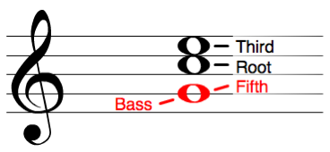
Triads: Second Inversion
In Second Inversion:
The FIFTH is in the Bass.

Slide 16
Triad Inversions:
For each inversion, you must memorize which member of the chord is in the bass.

Slide 17
Seventh Chord Inversions

Slide 18
Sevenths: Root Position
In Root Position,
The ROOT is in the Bass

Slide 19
Sevenths: First Inversion
To make a first inversion chord,
We move the root up an octave

Slide 20
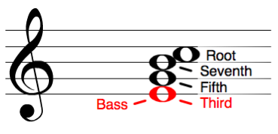
Sevenths: First Inversion
In First Inversion,
The THIRD is in the Bass

Slide 21
Sevenths: Second Inversion
To make a second inversion chord,
We move the root & 3rd up an octave.

Slide 22
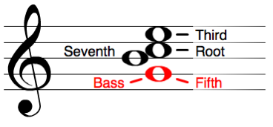
Sevenths: Second Inversion
In Second Inversion,
The FIFTH is in the Bass.

Slide 23
Sevenths: Third Inversion
To make a third inversion chord,
We move the root, 3rd & 5th up an octave.

Slide 24
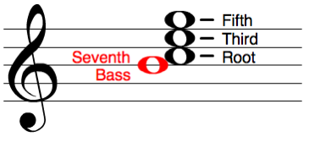
Sevenths: Third Inversion
In Third Inversion,
The SEVENTH is in the Bass.

Slide 25
Seventh Chord Inversions:
For each inversion, you must memorize which member of the chord is in the bass.

Slide 26
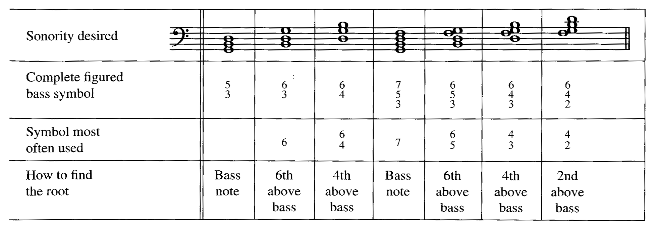
Inversion Symbols and Figured Bass
More on Figured Bass to come . . .

Slide 27
Inversion Hotline
664-765-4342
If you can remember a phone number, you can remember inversions!

Slide 28
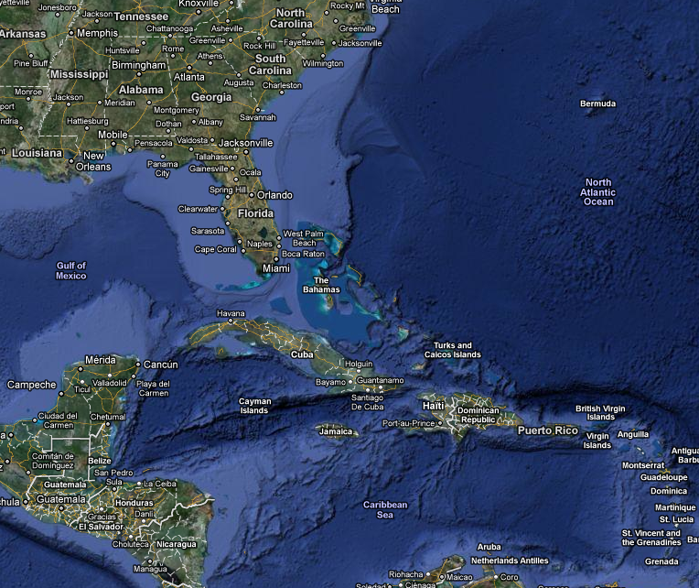
Seventh Chords
Inversion Hotline
Triads
Inversion Symbol
6
6
4
Lowest Note
Root
Third
Fifth
Inversion Symbol
7
6
5
4
3
4
2
Lowest Note
Root
Third
Fifth
Seventh
664-765-4342
1-664 is for Montserrat

Slide 29
Lead Sheet Symbols:

