Slide 1
Figured Bass
Kostka/Payne Chapter 3

Slide 2
In the last presentation, we learned about Triad and 7th Chord inversions.

Slide 3
Triad Inversions:
For each inversion, remember to memorize which member of the chord is in the bass.

Slide 4
Seventh Chord Inversions:
For each inversion, remember to memorize which member of the chord is in the bass.

Slide 5
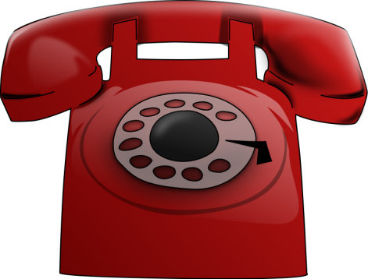
Inversion Hotline
664-765-4342
If you can remember a phone number, you can remember inversions!

Slide 6
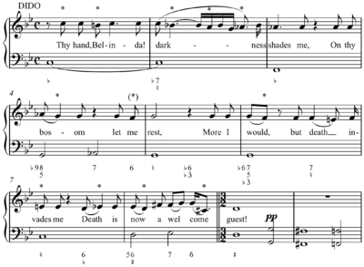
What is Figured Bass?
Figured bass, or thoroughbass, is a kind of integer musical notation used to indicate intervals, chords, and non-chord tones, in relation to a bass note.

Slide 8
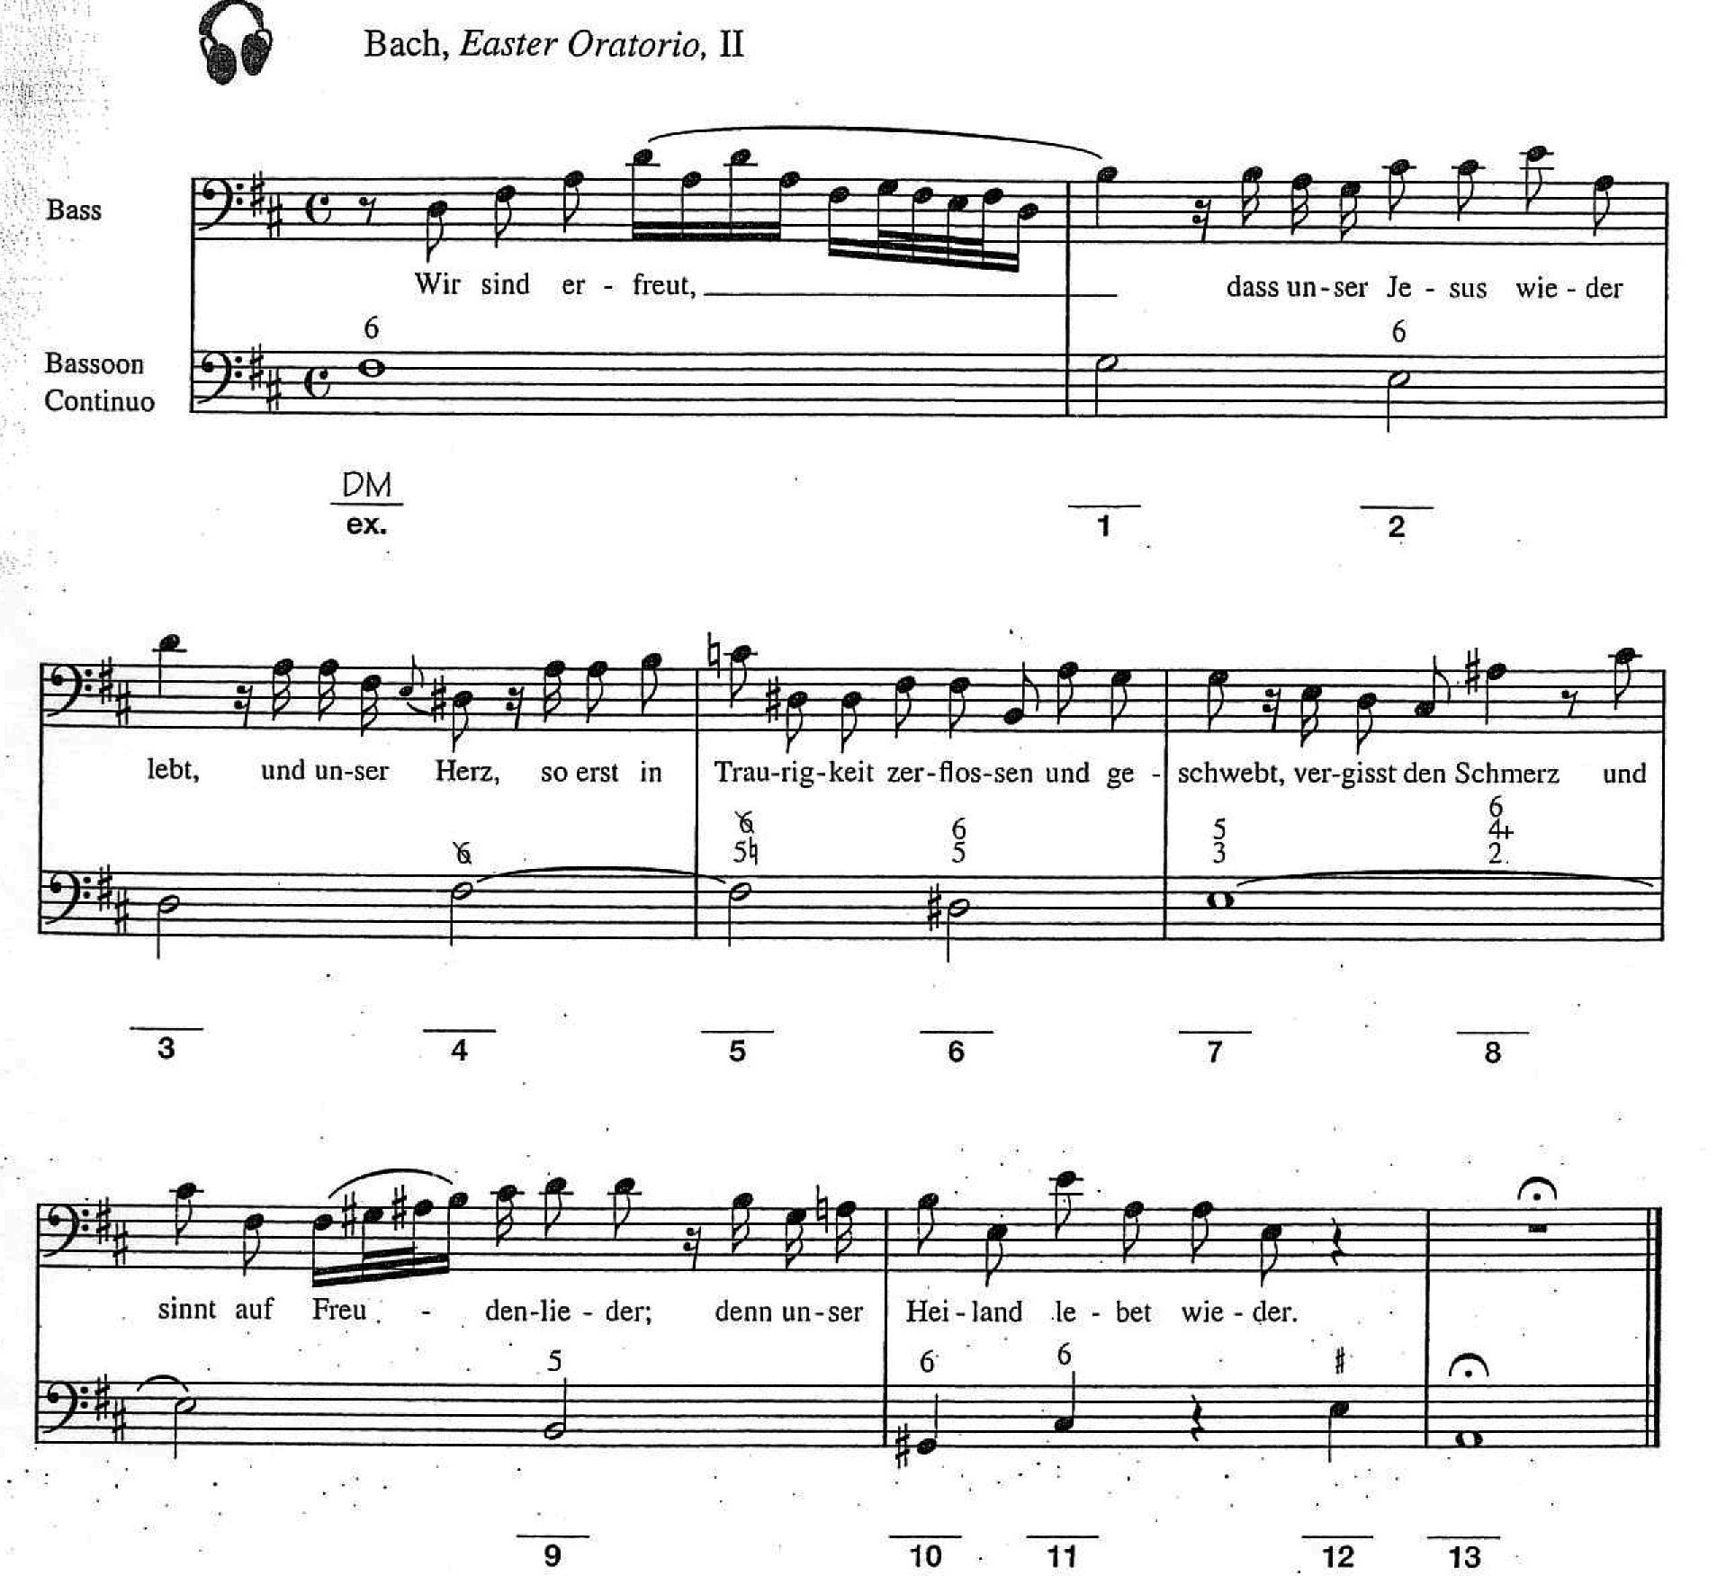

Slide 9
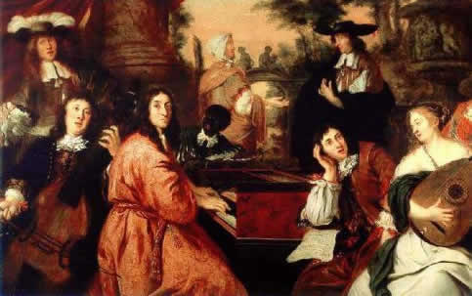
Figured bass is closely associated with basso continuo, an accompaniment used in almost all genres of music in the Baroque period, through rarely in modern music.

Slide 10
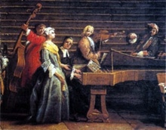
Continuo Group:
Consisted of one instrument capable
of playing chords: Harpsichord, organ, lute, or guitar.
AND
One or more “bass” instruments such as Cello, double bass, bass viol, bassoon.

Slide 11
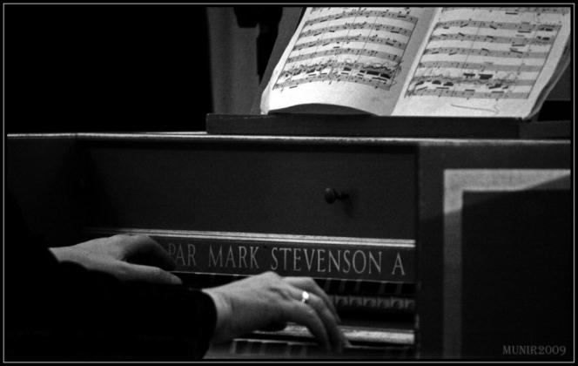
Continuo players (often keyboardists) were expected to be able to realize figured bass notation.

Slide 12
What does it all mean?

Slide 13
Figured Bass:
Write this down!
Figured bass means
“Intervals above the bass.”
And memorize it!

Slide 14
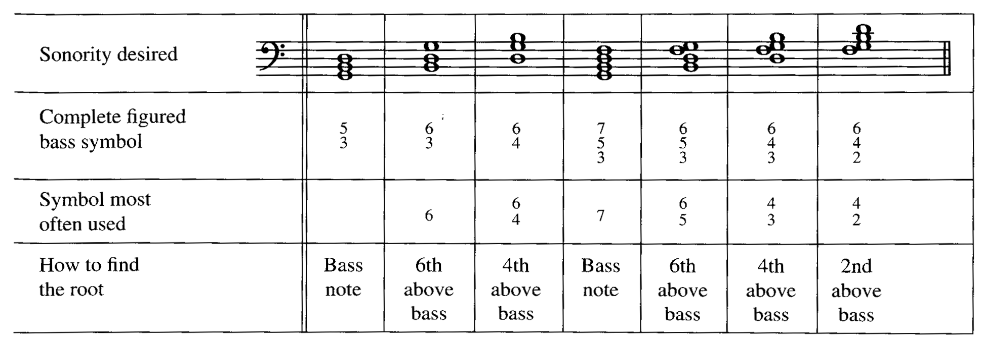
Inversion Symbols and Figured Bass

Slide 15
Inversion Symbols and Figured Bass

Slide 16
Inversion Symbols and Figured Bass

Slide 17
Inversion Symbols and Figured Bass

Slide 18
Inversion Symbols and Figured Bass

Slide 19
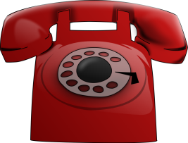
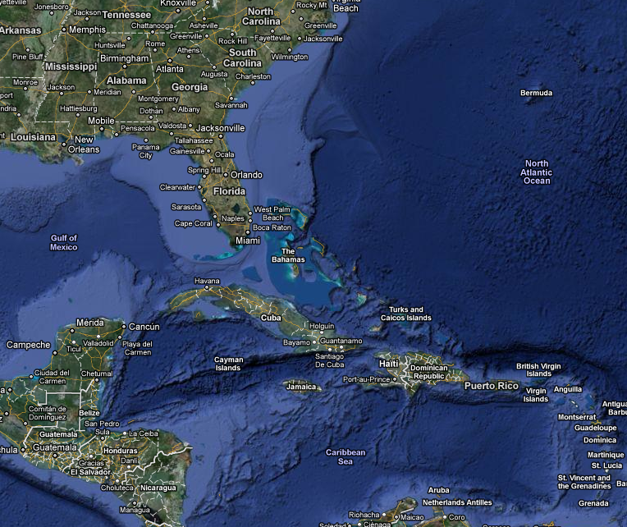
Seventh Chords
Inversion Hotline
Triads
Inversion Symbol
6
6
4
Lowest Note
Root
Third
Fifth
Inversion Symbol
7
6
5
4
3
4
2
Lowest Note
Root
Third
Fifth
Seventh
664-765-4342
1-664 is for Montserrat

Slide 20
Important Symbols:
♭♮♯+ \
Write the next page down!
And memorize it!

Slide 21
Important Symbols:
♭♮♯+ \
An accidental next to a roman numeral in the figured bass could be used to raise or lower a note.
An accidental by itself always refers to the 3rd ABOVE THE BASS.
A slash \ or plus + sign with an Arabic numeral means to raise that note.

