Slide 1
Voice-Leading
Kostka/Payne – Chapter 5

Slide 2
Melodic Critique
1. Rhythm: Keep rhythm simple. 2. Harmony: EVERY melody note should be represented in chord. 3. Contour: Melody should be CONJUNCT (stepwise) with a single (1) FOCAL POINT. 4. Leaps: Avoid AUG. intervals, 7th, larger than a P8
Interval larger than P4 approached and left in OPPOSITE direction Consecutive smaller leaps same direction and outline a TRIAD
5. Tendency Tones: Scale degree 7 moves to 1 Scale degree 4 moves to 3

Slide 3
Stems and Notation
Stems of the top part always point up and bottom part point down.
Ex 5-3

Slide 4
Voicing a chord
Voicing is how the chord is to be distributed or spaced.
Ex 5-4

Slide 5
Spacing
Close Structure – Less than an octave between soprano and tenor
Open Structure – An octave or more between soprano and tenor

Slide 6
Spacing Errors
• Avoid Crossed Voices
• Avoid overly spacious sonorities by keeping adjacent parts (excluding the bass) within an octave of each other.
A Spacing Error results from having more than an octave between two consecutive parts.

Slide 7
Vocal Ranges
• When composing for vocal ensembles use the ranges given below
Ex 5-9

Slide 8
Types of Motion
Ex 5-10
Of these five types of motion, parallel motion is the most significant.

Slide 9
Part-writing errors
The following slides detail part-writing errors which are to be avoided.
• Parallel 5ths and 8ves
• 5ths and 8ves by contrary motion
• Unequal 5ths
• Direct (Hidden) 5ths and 8ves

Slide 10
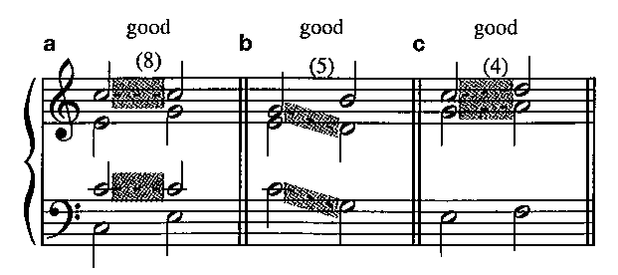
Objectionable Parallels
Parallel 5ths and 8ves:
When two parts are separated by a P5 or P8 and move to new pitches that are separated by the same interval.
Ex 5-12

Slide 11
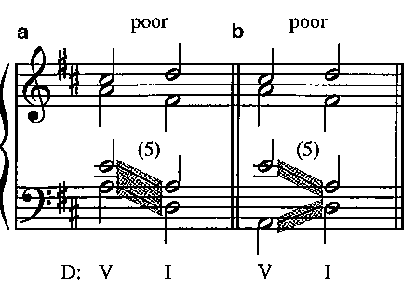
Contrary Motion
Consecutive 5ths and 8ves by contrary motion should be avoided.
Ex 5-13

Slide 12
Unequal 5ths
Unequal 5ths result when a P5 is followed by a dim 5th or the reverse.
**We will consider unequal 5ths an error when they involve dim. 5th – P5 between the bass and another voice.

Slide 13
Direct or Hidden 5th/8^{ve}
Direct 5th or 8^{ves} occur when all of the following conditions are satisfied:
• The outer 2 voices (soprano/bass) create
a 5th or 8^{ve} between them (on 2nd chord).
• These voices move in the same direction.
• There is a leap in the soprano part.
Direct 5^{ths} and 8^{ves} are part-writing errors.

Slide 14
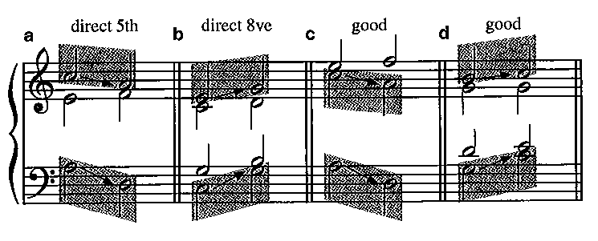
Direct or Hidden 5th/8^{ve}
Ex 5-16

